Slide 1

Branch - CSE Python Programming
Lecture – 7 Conditional Execution – Part 2
By
Dr. Smita Tiwari
Assistant Professor
Department of Computer Science and Engineering
School of Engineering & Technology

Slide 2
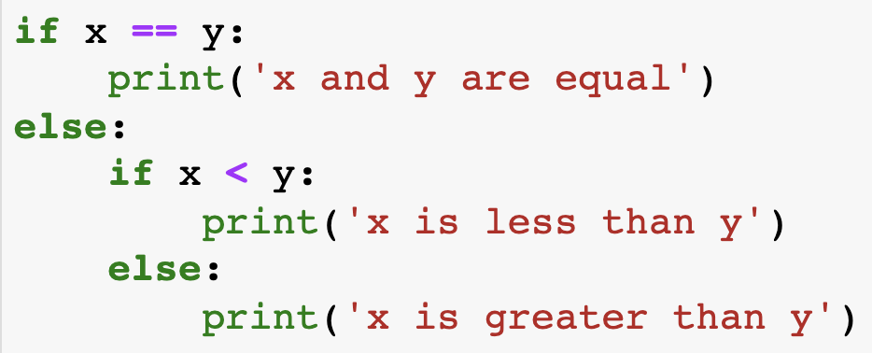
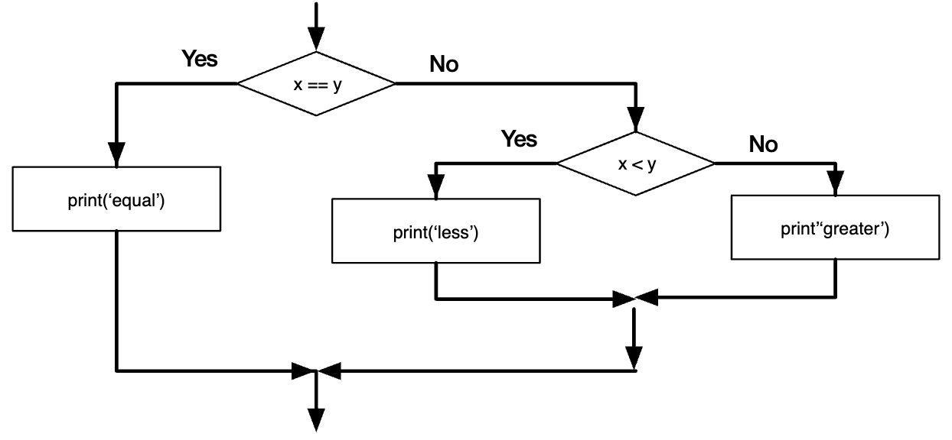
Nested conditionals (Contd.)
One conditional can also be nested within another. We could have written the three-branch example like this:

Slide 3

Class Quiz
What is the value of expression:
Run time crash/error
I don’t know / I don’t care
False
True
(5<2) and (3/0 > 1)
The correct answer is
False

Slide 4
Short-circuit Evaluation
Do not evaluate the second operand of binary short-circuit logical operator if the result can be deduced from the first operand
Also applies to nested logical operators
true
false
false
true
not( (2>5) and (3/0 > 1) ) or (4/0 < 2)
Evaluates to true

Slide 5
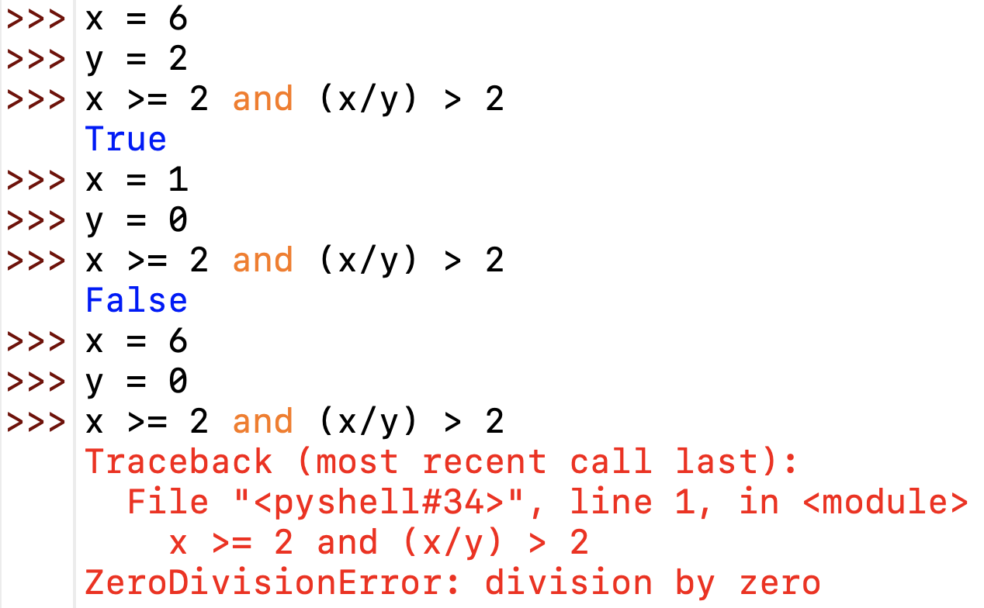
Short circuit Evaluation

Slide 6
3 Factors for Expr Evaluation
Precedence
Applied to two different class of operators
+ and *, - and *, and and or, …
Associativity
Applied to operators of same class
* and *, + and -, * and /, …
Order
Precedence and associativity identify the operands for each operator
Not which operand is evaluated first
Python evaluates expressions from left to right
While evaluating an assignment, the right-hand side is evaluated before the left-hand side.
Notes:
NOTE: add example to show the effect of order of evaluation

Slide 7
Class Quiz
What is the output of the following program:
y = 0.1*3
if y != 0.3:
print ('Launch a Missile')
else:
print ("Let's have peace")
Launch a Missile

Slide 8
Caution about Using Floats
Representation of real numbers in a computer can not be exact
Computers have limited memory to store data
Between any two distinct real numbers, there are infinitely many real numbers.
On a typical machine running Python, there are 53 bits of precision available for a Python float

Slide 9
Caution about Using Floats
The value stored internally for the decimal number 0.1 is the binary fraction
Equivalent to decimal value
Approximation is similar to decimal approximation 1/3 = 0.333333333...
No matter how many digits you use, you have an approximation
0.00011001100110011001100110011001100110011001100110011010
0.1000000000000000055511151231257827021181583404541015625

Slide 10
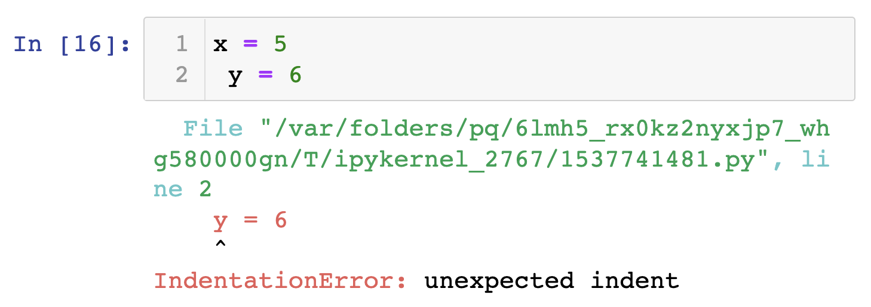
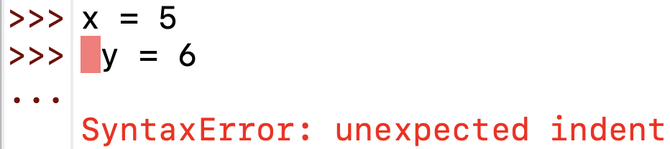
Debugging
Python displays the traceback when an error occurs and contains a lot of information, but it can be overwhelming. The useful parts are usually:
What kind of error it was, and
Where it occurred.
Syntax errors are usually easy to find, but there are a few “catches”. Whitespace errors can be tricky because spaces and tabs are invisible, and we ignore them.
Here, the 2nd line is idented by one space. But the error message points to y, which is misleading. Python IDLE 3.10.1 points to the exact error spot now.
Output from Python IDLE 3.10.1
Output from Python 3.8 (Jupyter Notebook)

Slide 11
THANK YOU

